Slide 1


Conditionals and Counterfactuals
in Standard American English
Review, in all aspects

Slide 2
Conditionals: 3 types
Real Conditionals
Unreal Conditionals
The “Wish” Construction

Slide 3
Presentation Outline
We will cover these skills
How to make the form
What each conditional means
How to use the forms

Slide 4
Real Conditionals
Present Tense:
Statement of general truth: If the sun is shining, it is daytime. If animals are hungry, they eat. (If = When)
Statement of habit: If I feel sick, I go to the doctor. If I drink coffee at night, I don’t feel well. (If = When)
Situational instructions: If you are tired, go to bed. If you need anything, call me.
Future Tense*:
Future prediction: If you don’t sleep, you will feel terrible. If you answer that call, you’ll be late to work.
Past Tense :
Statement of comparison: If he was the tallest, his brother was the smartest. (If = even though)
If he ran a mile, his brother ran two miles. (= his brother ran twice as far as he did)
Statement of habit: If he went to the park, she went with him. If the weather was nice, she often walked to work. (If = Whenever)
Mixed time:
If he left yesterday, then you can go wherever you want now. (If = Given that, Since)
If she’s still here, you didn’t scare her away. (If = Given that, Since)
Real Conditionals
Unreal Conditionals
Wish Clauses
Conclusion

Slide 5
*Special Notes: Future Conditionals
You may have noticed that in future conditionals, the verb after if does not use will.
The present tense is required in future clauses that start with if.
The same is true in future clauses with before, after, until, as soon as, when, while, and once. These are called time clauses.
For example:
If you buy that car, you will regret it.
He will start the process if he sees the order.
Reminder:
In academic writing, teachers often ask students to follow “tense consistency.”
If the first verb in the progressive or perfect aspect is in present or future tense, then the verb form is allowed in future paragraphs.

Slide 6
Unreal Conditionals
Present, Future – Use past tense in if clause, would/could/might in main clause *Note: in unreal present, be is in the were form
If your great-grandmother were here, she would be so proud of you.
If I helped you now, I might get in trouble. If I helped you now, I could lose my job.
If I were to arrive tomorrow, it would be too late.
If she came to me for help next week, I wouldn’t answer the phone.
Past – Use past perfect in if clause, would have/could have/might have + p.p. in main clause
If I had known his name, I wouldn’t have asked him for it. (I didn’t know his name. I asked him for it.)
If she had seen the problem, she could have fixed it. (She didn’t see the problem. She didn’t fix it.)
If you had treated me better, I might have helped you. (You didn’t treat me well. I didn’t help you.)
Mixed
If I knew your name, I wouldn’t have used the wrong name. (I don’t know your name. I used the wrong name.)
If you had told me the truth, we wouldn’t be here now. (You didn’t tell the truth. We are here now.)
Real Conditionals
Unreal Conditionals
Wish Clauses
Conclusion

Slide 7
Conditionals: Practice!
Real or Unreal?
If I were you, I wouldn’t watch that movie.
If he got the beauty, she got the brains.
If all goes well, I’ll be in Malta tomorrow.
If all had gone well, I’d be in Malta tomorrow.
If he had gotten the idea, she’d be here today.

Slide 8
Conditionals: Practice!
Fix the mistakes.
If I was you, I wouldn’t watch that movie.
If he had gotten the idea, she is here today.
If all goes well, I’d be in Malta tomorrow.
She wouldn’t come yesterday if she had already finished everything.
If all had gone well, I’ll be in Malta tomorrow.

Slide 9
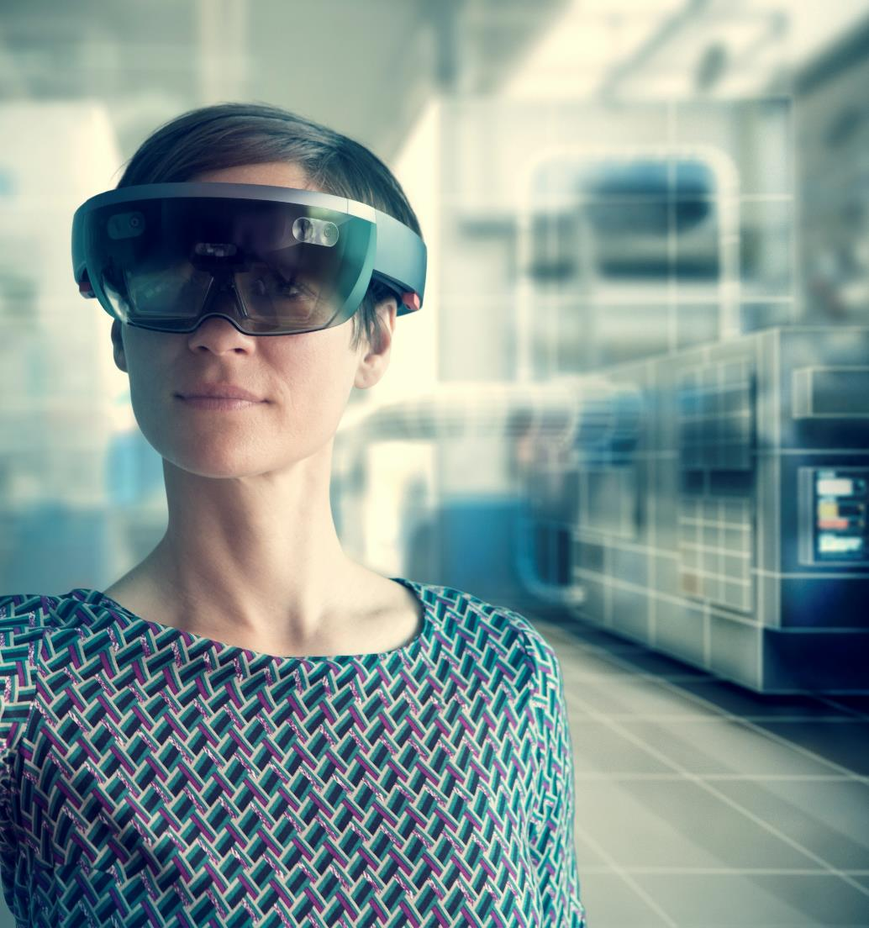
Wish Clauses
After the wish verb, the unreal verb form is required.
Hypothetical/Volitional (Present or Future): Use would (past will)
I wish she would come to the party tomorrow! (She might change her mind.)
She wishes he would listen when she talks. (He doesn’t listen, but she thinks he can change.)
Counterfactual Present: Use past tense
I wish she were here now. (I know she isn’t.)
They wish she knew the truth.
She wishes she could sing.
Counterfactual Future: Use past progressive
I wish you were coming with us tomorrow. (I know you won’t.)
She wishes they were attending her play tonight.
Past: Use past perfect
I wish you had told me about your problem. (You didn’t.)
She wishes he had helped her.
They wish they had listened to her
Wish Clauses
Real Conditionals
Unreal Conditionals
Conclusion

Slide 10
Summary
Here is what we learned:
Real Conditionals:
Usually the same tense in both clauses
Future conditionals use the present tense in the if clause because they act like a future time clause
Conditionals can have mixed times
Unreal Conditionals:
To express unreal situations, shift to the past with modals
Usually, would is required in the main clause, but could and might can be used instead
Wish Clauses:
Counterfactual wish clauses require the same unreal forms as unreal conditionals
Hypothetical wish clauses (nonexistent in the past) use would
Hypothetical wish clauses communicate the subject’s desire
Conclusion
Real Conditionals
Unreal Conditionals
Wish Clauses

